Slide 1
Statistics for Data Science
17/04/2024

Slide 2
Course Overview
Basic knowledge of linear algebra is necessary to develop new algorithms for machine learning and data science.

Slide 3
Topics
• Sample and population data.
• The fundamentals of descriptive statistics
• Measures of central tendency, asymmetry, and variability
• Practical example: descriptive statistics
• Distributions
• Estimators and estimates
• Confidence intervals: advanced topics
• Practical example: inferential statistics
• Hypothesis testing: Introduction
• introduction to Probability
• Conditional Probability.
• Bay’s theorem
• Vectors vs Matrices.
• Vectors Magnitude and direction.
• Cos similarity between vectors.
• Matrix operations (dot product, multiplication, addition, subtraction, inverse).

Slide 4
What is Statistics ?
Statistics is the science concerned with developing and studying methods for collecting, analyzing, interpreting and presenting empirical data البيانات التجريبية.
Statistics is a highly interdisciplinary متعدد التخصصات field.
Research in statistics finds applicability in virtually all scientific fields and research questions in the various scientific fields motivate the development of new statistical methods and theory.
In developing methods and studying the theory that underlies the methods statisticians draw on a variety of mathematical and computational tools.
Two fundamental ideas in the field of statistics are uncertainty and variation.

Slide 5
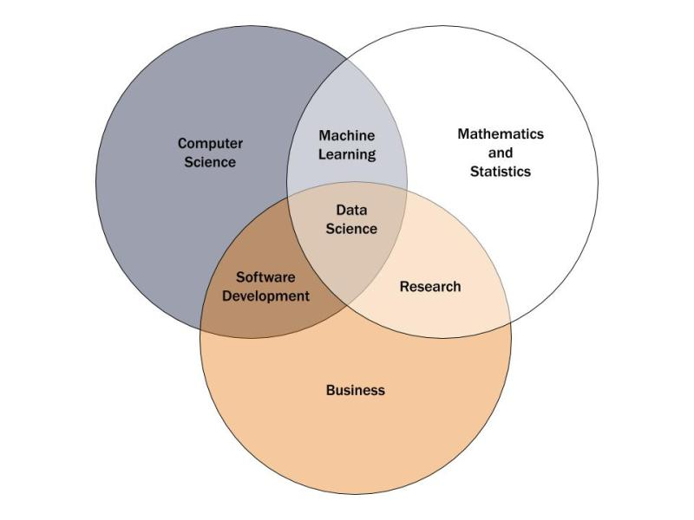
Statistics In Data Science
In data science, statistics is at the core of sophisticated machine learning algorithms, capturing and translating data patterns into actionable evidence.
Data scientists use statistics to gather, review, analyse, and draw conclusions from data, as well as apply quantified mathematical models to appropriate variables.

Slide 6
Statistics In Data Science
Statistical functions are used in data science to analyse raw data, build data models, and infer results. Below is a list of the key statistical terms:
Population: the source of data to be collected.
Sample: a portion of the population.
Variable: any data item that can be measured or counted.
Quantitative analysis (statistical): كمى collecting and interpreting data with patterns and data visualization.
Qualitative analysis (non-statistical): كيفىproducing generic information from other non-data forms of media.
Descriptive statistics: characteristics of a population.
Inferential statistics: predictions for a population.
Central tendency (measures of the center): mean (average of all values), median (central value of a data set), and mode (the most recurrent value in a data set).
Measures of the spread:
Range: the distance between each value in a data set.
Variance: the distance between a variable and its expected value.
Standard deviation: the dispersion تشتتof a data set from the mean.

Slide 7
Skills Needed ?
Data manipulation
Critical thinking and attention to detail
Organization
Innovation and problem solving
Communication
Statistics

Slide 8
Variables
A variable is any characteristics, number, or quantity that can be measured or counted.
A variable may also be called a data item. Age, sex, business income and expenses, country of birth, capital expenditure نفقات راسماليه, class grades, eye colour and vehicle type are examples of variables.
It is called a variable because the value may vary between data units in a population, and may change in value over time.

Slide 9
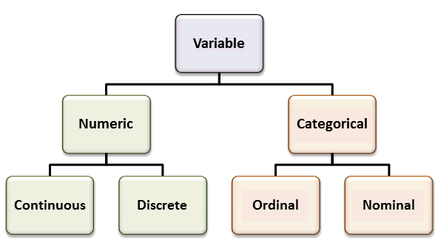
A, B, C

Slide 10
Types of Variables
Numeric variables have values that describe a measurable quantity as a number, like 'how many' or 'how much'. Therefore, numeric variables are quantitative variables.
Numeric variables may be further described as either continuous or discrete:
A continuous variable is a numeric variable. Observations can take any value between a certain set of real numbers. The value given to an observation for a continuous variable can include values as small as the instrument of measurement allows. Examples of continuous variables include height, time, age, and temperature.
A discrete variable is a numeric variable. Observations can take a value based on a count from a set of distinct whole values. A discrete variable cannot take the value of a fraction between one value and the next closest value. Examples of discrete variables include the number of registered cars, number of business locations, and number of children in a family, all of of which measured as whole units (i.e. 1, 2, 3 cars).

Slide 11
Types of Variables
Categorical variables have values that describe a 'quality' or 'characteristic' of a data unit, like 'what type' or 'which category'. Categorical variables fall into mutually exclusive (in one category or in another) and exhaustive (include all possible options) categories. Therefore, categorical variables are qualitative variables and tend to be represented by a non-numeric value.
Categorical variables may be further described as ordinal or nominal:
An ordinal variable is a categorical variable. Observations can take a value that can be logically ordered or ranked. The categories associated with ordinal variables can be ranked higher or lower than another, but do not necessarily establish a numeric difference between each category. Examples of ordinal categorical variables include academic grades (i.e. A, B, C), clothing size (i.e. small, medium, large, extra large) and attitudes (i.e. strongly agree, agree, disagree, strongly disagree).
A nominal variable is a categorical variable. Observations can take a value that is not able to be organised in a logical sequence. Examples of nominal categorical variables include sex, business type, eye colour, religion and brand.

Slide 12
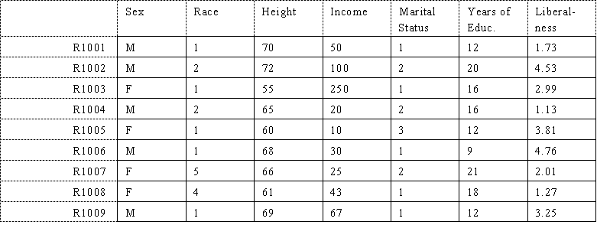
Working with Matrices
matrix, a set of numbers arranged in rows and columns so as to form a rectangular array. The numbers are called the elements, or entries, of the matrix.

Slide 13
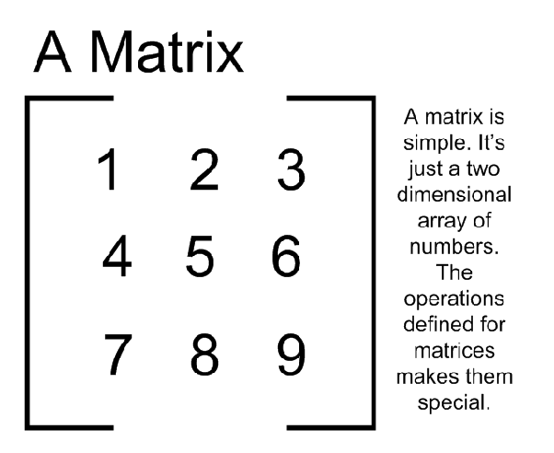
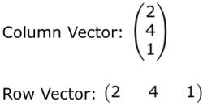
Working with Matrices

Slide 14
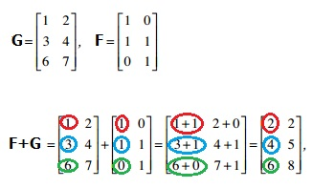
Matrices Addition / Subtraction

Slide 15
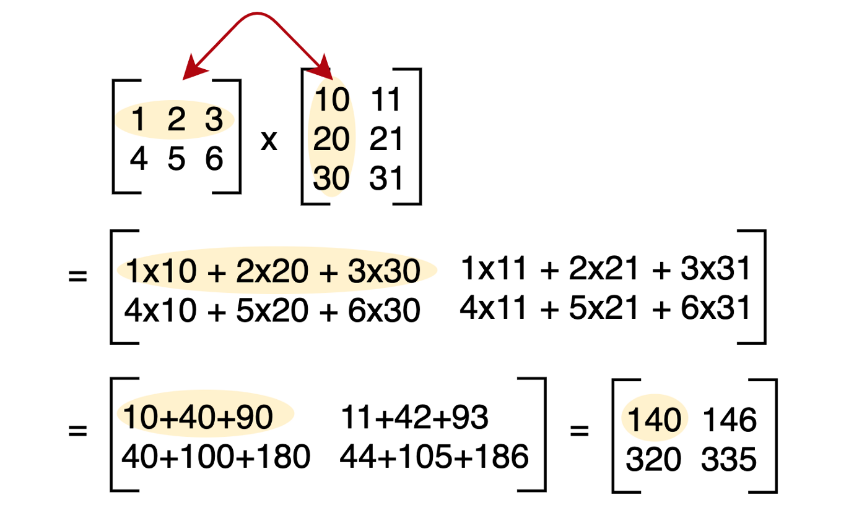
Matrices Multiplication

Slide 16
Q&A
Questions and answers

Slide 17
Frequency Table
A frequency table lists a set of values and how often each one appears.
Frequency is the number of times a specific data value occurs in your dataset.
These tables help you understand which data values are common and which are rare.
These tables organize your data and are an effective way to present the results to others.
Frequency tables are also known as frequency distributions because they allow you to understand the distribution of values in your dataset.

Slide 18
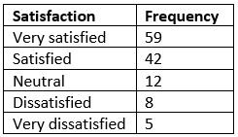
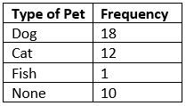
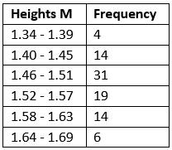
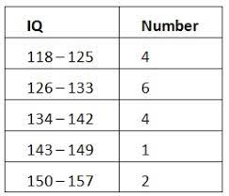
Frequency Table

Slide 19
Mean, Median and Mode
Mean, median, and mode are different measures of center in a numerical data set. They each try to summarize a dataset with a single number to represent a "typical" data point from the dataset.
Mean: The "average" number; found by adding all data points and dividing by the number of data points.
“Affected By Outliers”
Example: The mean of 4, 1, and 7 is (4+1+7)/3 = 12/3 = 4.
Median: The middle number; found by ordering all data points and picking out the one in the middle (or if there are two middle numbers, taking the mean of those two numbers).
“More reliable to substitute missing data points”
Example: The median of 4, 1, and 7 is 4 because when the numbers are put in order the number 4 is in the middle.
Mode: The most frequent number—that is, the number that occurs the highest number of times.
Example: The mode of { 4, 2, 4, 3, 2, 2} is 2 because it occurs three times, which is more than any other number.

Slide 20
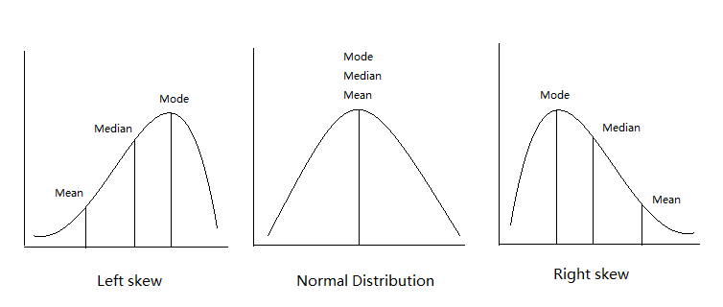
Mean, Median and Mode

Slide 21
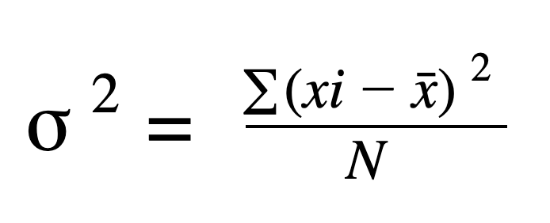
Variance
variance is a measure of how far a set of data are dispersed out from their mean or average value. It is denoted as ‘σ2’.
xi is the one sample of the data
X hat is the mean or average of the data points
Properties of Variance
It is always non-negative since each term in the variance sum is squared and therefore the result is either positive or zero.
Variance always has squared units.
For example, the variance of a set of weights estimated in kilograms will be given in kg squared. Since the population variance is squared, we cannot compare it directly with the mean or the data themselves.
Low value of varience is the best

Slide 22
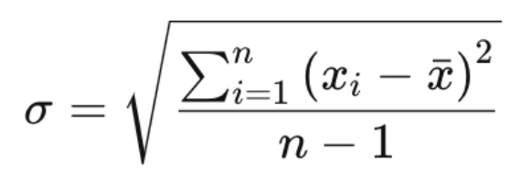
Standard Deviation
Distribution measures the deviation of data from its mean or average position. The degree of dispersion is computed by the method of estimating the deviation of data points. It is denoted by the symbol, ‘σ’.
Properties of Standard Deviation
It describes the square root of the mean of the squares of all values in a data set and is also called the root-mean-square deviation.
The smallest value of the standard deviation is 0 since it cannot be negative.
When the data values of a group are similar, then the standard deviation will be very low or close to zero. But when the data values vary with each other, then the standard variation is high or far from zero.
درجة التشتت

Slide 23
Range and Interquartile Range
The interquartile range is a measure of where the “middle fifty” is in a data set. Where a range is a measure of where the beginning and end are in a set, an interquartile range is a measure of where the bulk of the values lie. That’s why it’s preferred over many other measures of spread when reporting things like school performance or SAT scores.
The interquartile range formula is the first quartile subtracted from the third quartile:
IQR = Q3 – Q1.
Range: The difference between the highest and lowest values in a dataset.
Interquartile Range (IQR):The difference between the third quartile (Q3) and the first quartile (Q1) in a dataset.
They're used to measure the spread of data, with IQR being less sensitive to outliers than the range. They provide insights into data distribution and are easy to interpret and calculate.

Slide 24
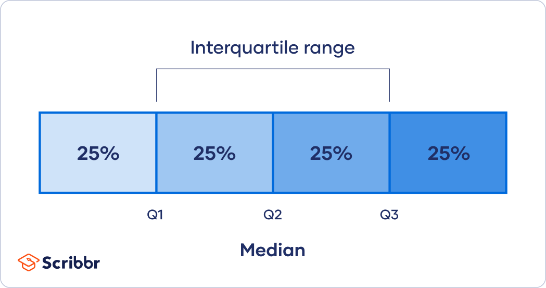
1st quartile and 3rd quartile
Quartiles segment any distribution that’s ordered from low to high into four equal parts. The interquartile range (IQR) contains the second and third quartiles, or the middle half of your data set.

Slide 25
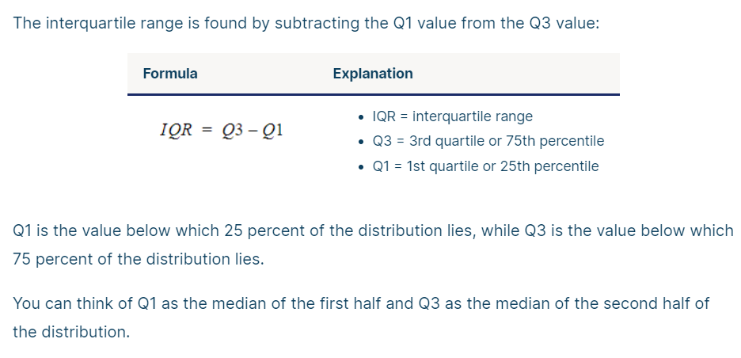
Quartile Calculations

Slide 26
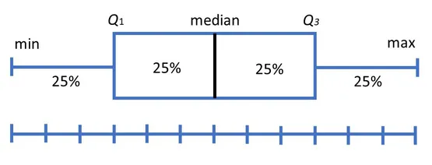
Box Plot
Box plots divide the data into sections that each contain approximately 25% of the data in that set.
Box plots are useful as they provide a visual summary of the data enabling researchers to quickly identify mean values, the dispersion of the data set, and signs of outliers.

Slide 27
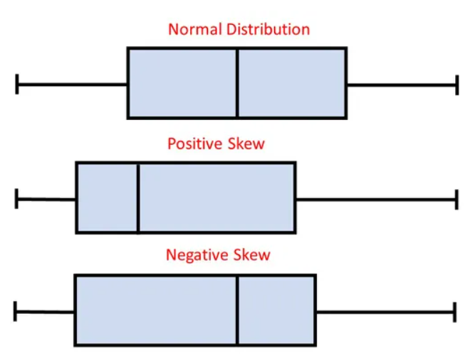
Box Plot

Slide 28
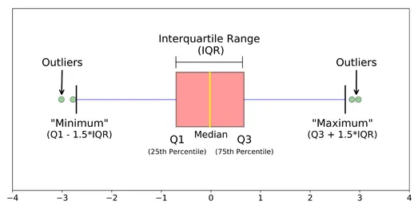
Box Plot
When reviewing a box plot, an outlier is defined as a data point that is located outside the whiskers of the box plot.

Slide 29
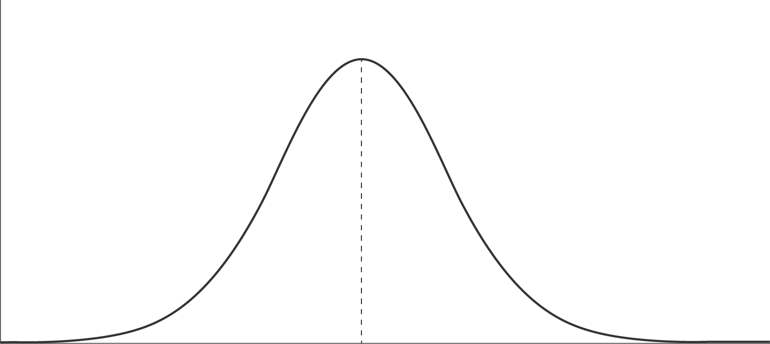
Normal Distribution
The normal distribution, also known as a Gaussian distribution or “bell curve” is the most common frequency distribution. This distribution is symmetrical, with most values falling towards the centre and long tails to the left and right. It is a continuous distribution, with no gaps between values.
Later we can use this to identify the outliers

Slide 30
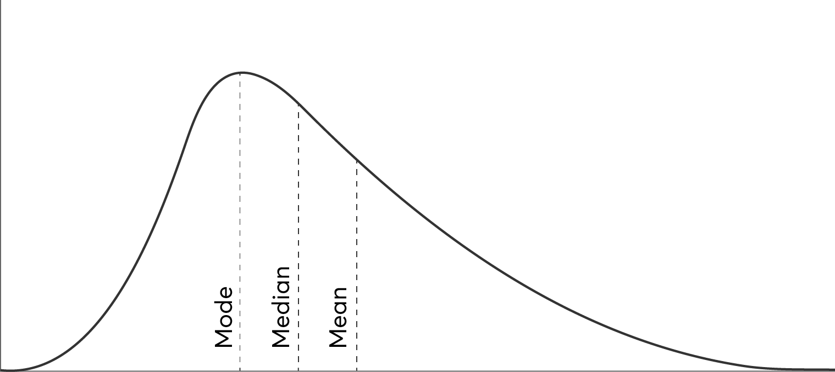
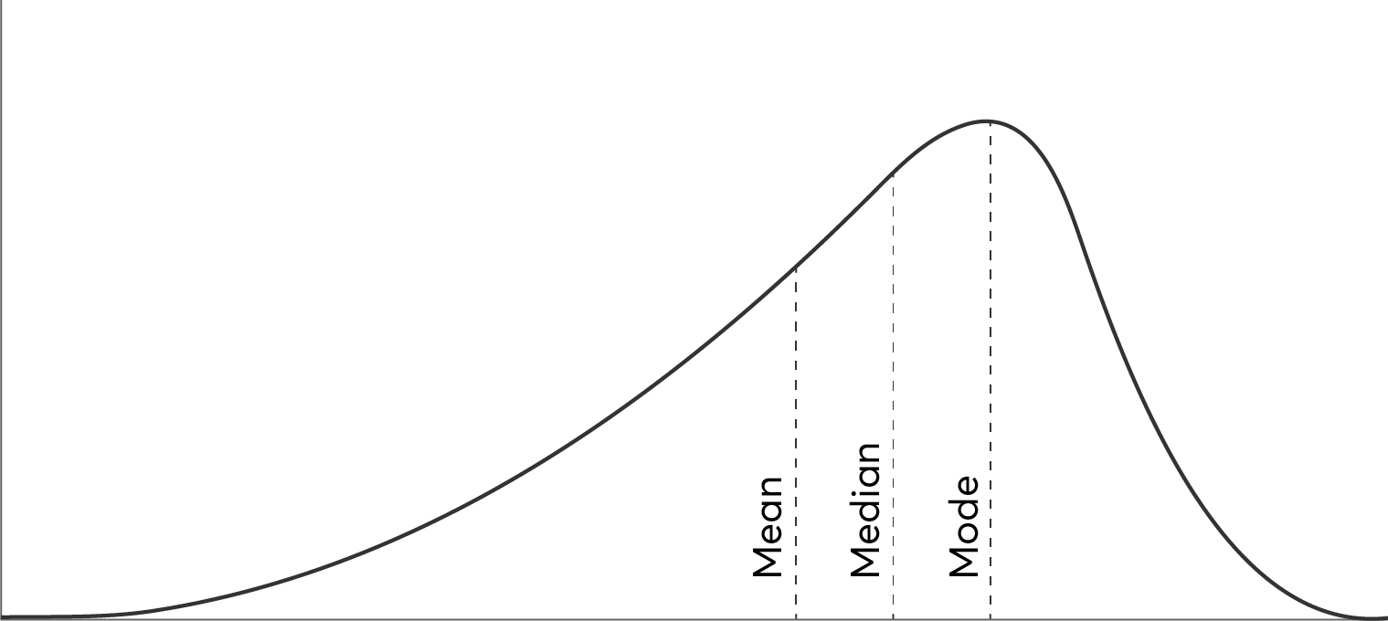
Skewed Distribution
One important fact about skewed distributions is that, unlike a bell curve, the mode, median and mean are not the same value. The long tail skews the mean and median in the direction of the tail. There is a very easy way to calculate the different average values using a histogram diagram. If you rely on average values to make quick predictions, pay attention to which average you use!

Slide 31
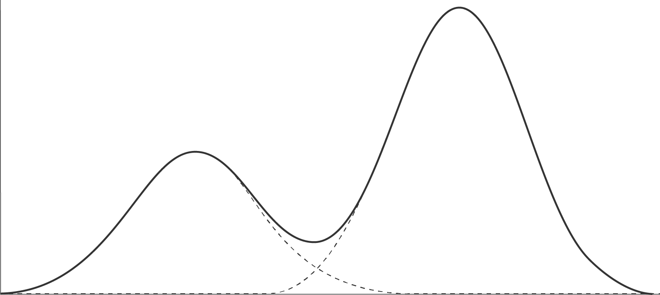
Bimodal/Multimodal Distribution
A bimodal distribution occurs when two unimodal distributions are in the group being measured. When more than two peaks occur, its known as a multimodal distribution.This distribution can be split into two or more groups..
If you spot a bimodal frequency distribution, it’s worth checking if you can split the measured data into sub-groups to see the shape for each group.

Slide 32
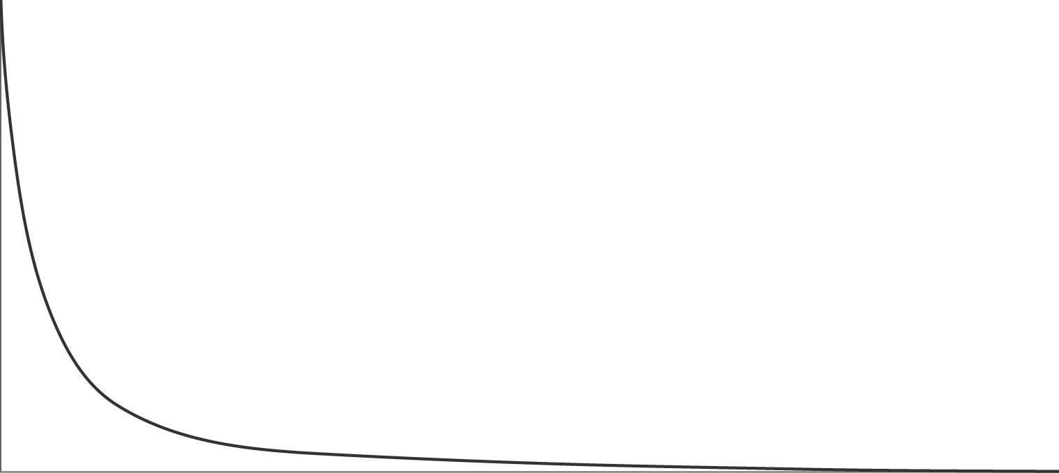
Logarithmic Distribution
Some data sets have nearly all their frequency values clustered to one side of the graph. This frequency distribution shape is known as logarithmic. A common example of this in real life is found in distributions of wealth and income, with large numbers of people at the bottom but extreme outliers extending the tail to the right.

Slide 33
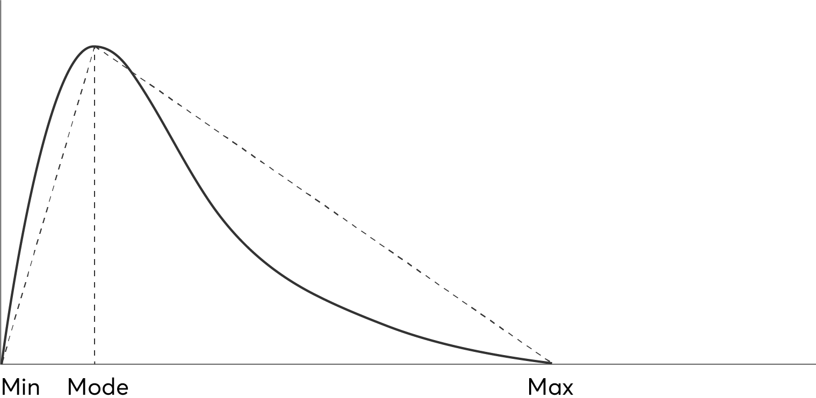
Triangular Distribution
While the triangular distribution is a simple shape made using straight lines between each of the 3 values, the PERT distribution assumes that the long tail values appear less frequently. The frequency distribution shape generated from these three values is then used to estimate likely completion times.

Slide 34
Q&A
Questions and answers

Slide 35
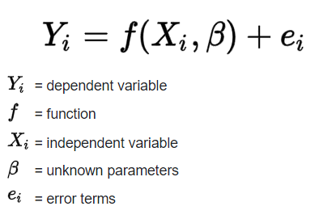
Regression
Regression is a statistical method used in finance, investing, and other disciplines that attempts to determine the strength and character of the relationship between one dependent variable (usually denoted by Y) and a series of other variables (known as independent variables)

Slide 36
Regression Analysis
Regression analysis is a powerful tool for uncovering the associations between variables observed in data, but cannot easily indicate causation. It is used in several contexts in business, finance, and economics. For instance, it is used to help investment managers value assets and understand the relationships between factors such as commodity prices and the stocks of businesses dealing in those commodities.
A regression is a statistical technique that relates a dependent variable to one or more independent (explanatory) variables.
A regression model is able to show whether changes observed in the dependent variable are associated with changes in one or more of the explanatory variables.
It does this by essentially fitting a best-fit line and seeing how the data is dispersed around this line.
Regression helps economists and financial analysts in things ranging from asset valuation to making predictions.
In order for regression results to be properly interpreted, several assumptions about the data and the model itself must hold.

Slide 37
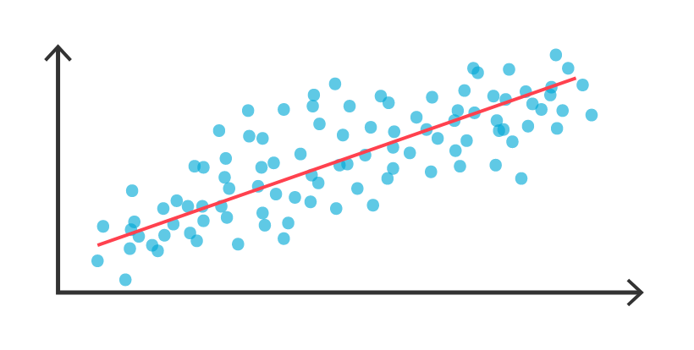
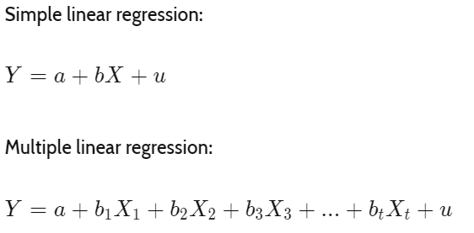
Regression types
​

Slide 38
Elementary Probability
A probability gives the likelihood that a defined event will occur. It is quantified as a positive number between 0 (the event is impossible) and 1 (the event is certain). Thus, the higher the probability of a given event, the more likely it is to occur.
Key concepts in elementary probability include:
Sample Space: The set of all possible outcomes of a random experiment.
Event: A subset of the sample space, representing a particular outcome or a collection of outcomes.
Probability: A numerical measure of the likelihood of an event occurring, ranging from 0 (impossible) to 1 (certain).
Probability of an Event: The ratio of the number of favorable outcomes to the total number of outcomes in the sample space.
For example, when rolling a fair six-sided die, the sample space consists of {1, 2, 3, 4, 5, 6}. The probability of rolling a 3 is 1/6 because there is one favorable outcome (rolling a 3) out of six possible outcomes.

Slide 39
Probability Rules
Given two events A and B, we often want to determine the probability of either event, or both events, occurring.
Addition Rule
The addition rule is used to determine the probability of at least one of two (or more) events occurring. In general, the probability of either event A or B is given by:
P(A or B) = P(A) + P(B) – P(A and B)
If A and B are mutually exclusive, this means they cannot occur together, i.e. P(A and B)=0. Therefore, for mutually exclusive events the probability of either A or B occurring is given by:
P(A or B) = P(A) + P(B)
Suppose you have a bag containing 5 red balls and 3 blue balls. You randomly pick one ball from the bag. Let event A be selecting a red ball, and event B be selecting a blue ball
P(A): Probability of selecting a red ball = Number of red balls / Total number of balls = 5/8
𝑃(𝐵): Probability of selecting a blue ball = Number of blue balls / Total number of balls = 3/8
𝑃(𝐴∩𝐵): Probability of selecting both a red and a blue ball = 0 (since it's impossible to select both simultaneously)
Using the addition rule: 𝑃(𝐴∪𝐵)=𝑃(𝐴)+𝑃(𝐵)−𝑃(𝐴∩𝐵) 𝑃(𝐴∪𝐵)=(5/8)+(3/8)−0=8/8=1P(A∪B)=(5/8)+(3/8)−0=8/8=1

Slide 40
Probability Rules
Multiplication Rule
The multiplication rule gives the probability that two (or more) events happen together. In general, the probability of both events A and B occurring is given by:
P(A and B) = P(A) x P(B|A) = P(B) x P(A|B)
The notation P(B|A) is the probability that event B occurs given that event A has occurred where the symbol ‘|’ is read is ‘given’. This is an example of a conditional probability, the condition being that event A has happened.
If A and B are independent events, then the probability of event B is unaffected by the probability of event A (and vice versa). In other words, P(B|A) = P(B). Therefore, for independent events, the probability of both events A and B occurring is given by:
P(A and B) = P(A) x P(B)

Slide 41
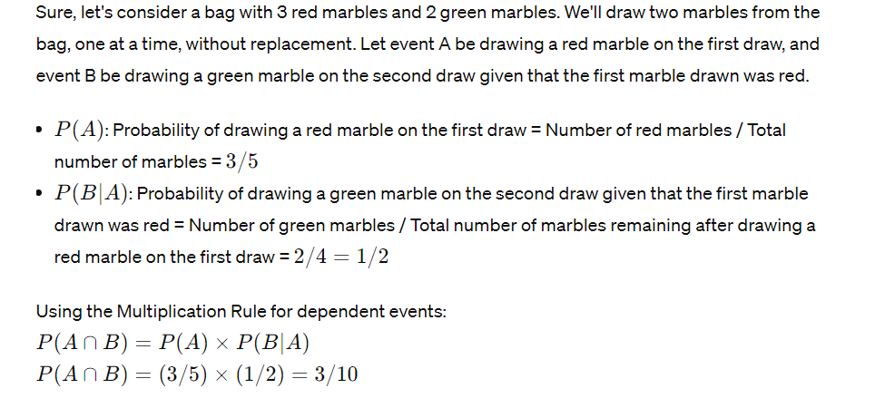
Example

Slide 42

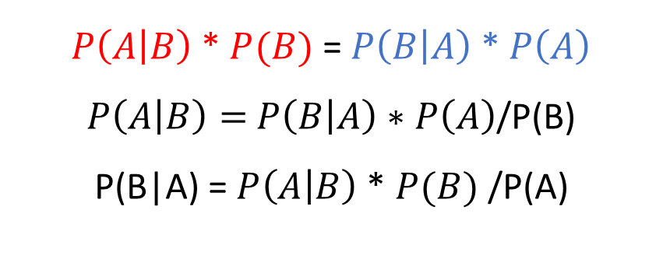
Bayes Theorem
Bayes Theorem Statement
$P\left(A | B\right)=\frac{P\left(A\text{∩}B\right)}{P(B)}$ P(B) > 0
$P\left(B | A\right)=\frac{P\left(\text{B}\text{∩}A\right)}{P(A)} P\left(A\right)>0$
$P\left(A\text{∩}B\right)$ = $P\left(B\text{∩}A\right)$
$P\left(A\text{∩}B\right)$ = $P\left(A | B\right)$ * $P(B)$
$P\left(\text{B}\text{∩}\text{A}\right)=P\left(B | A\right)$ * $P\left(A\right)$
$P\left(A | B\right)$ * $P(B)$ = $P\left(B | A\right)$ * $P\left(A\right)$
$P\left(A | B\right)=$ $P\left(B | A\right)∗P\left(A\right)$/P(B)
P(B|A) = $P\left(A | B\right)$ * $P(B)$ /P(A)

Slide 43

Bayes Theorem
$$Event A = P(A) = 2/5$$
$$Event B = P(B/A)=1/4$$
$$P(A ∩ B) = 2/5 ∗ ¼ = 1/10$$
$$P\left(B | A\right)= \frac{P\left(B∩A\right)}{P\left(A\right)} =\frac{\left(\frac{1}{10}\right)}{\left(\frac{2}{5}\right)}=\frac{1}{4}$$

Slide 44
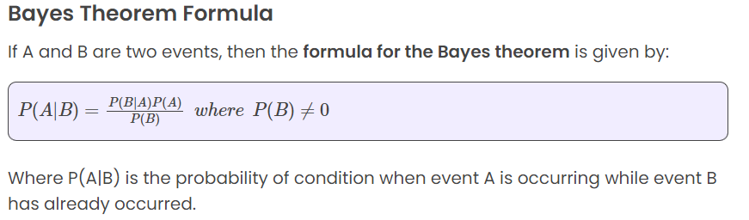
Bayes Theorem

Slide 45
Vectors vs Matrices
Vectors
We begin by defining vectors, relations among vectors, and elementary vector operations.
Definition. A k-dimensional vector y is an ordered collection of k real numbers y1, y2, . . . , yk , and is
written as y = (y1, y2, . . . , yk ). The numbers y j (j = 1, 2, . . . , k) are called the components of the vector y.

Slide 46
Vectors
i) (1, −3, 0, 5) is a four-dimensional vector. Its first component is 1, its second component is −3, and its third and fourth components are 0 and 5, respectively.
ii) The coefficients c1, c2, . . . , cn of the linear-programming objective function determine the n-dimensional
vector c = (c1, c2, . . . , cn).
iii) The activity levels x1, x2, . . . , xn of a linear program define the n-dimensional vector x = (x1, x2, . . . , xn).
iv) The coefficients ai1, ai2, . . . , ain of the decision variables in the ith equation of a linear program determine an n-dimensional vector A
i = (ai1, ai2, . . . , ain).

Slide 47
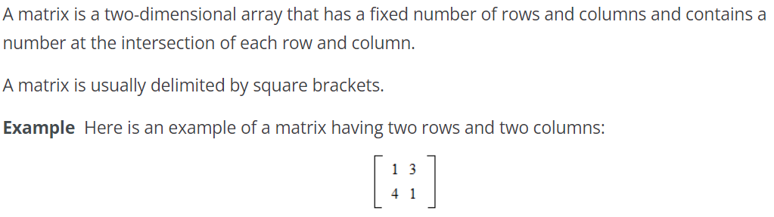
Matrices

Slide 48
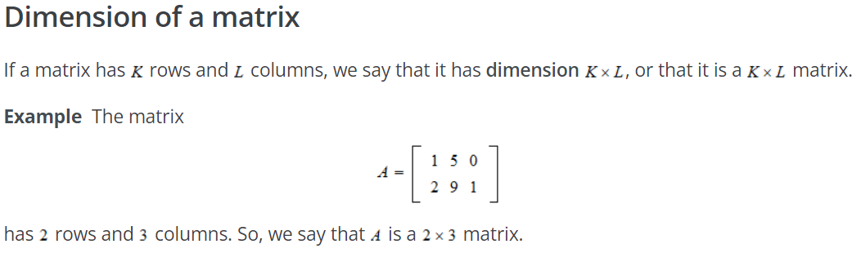
Matrices

Slide 49
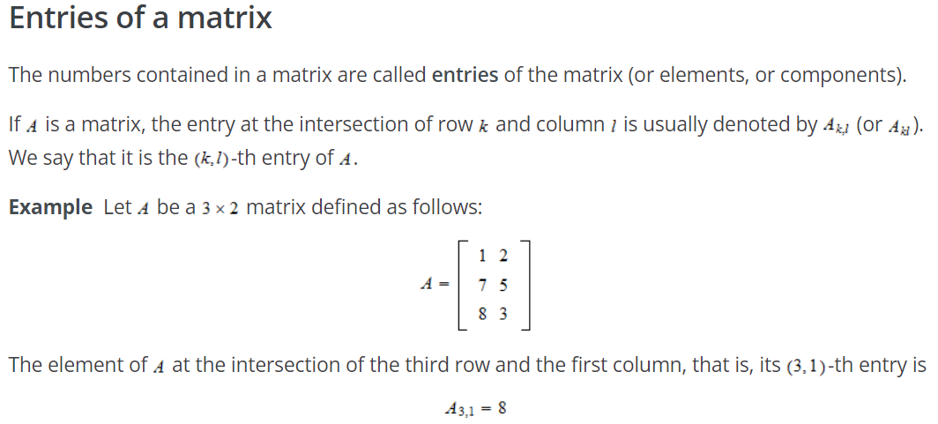
Matrices

Slide 50

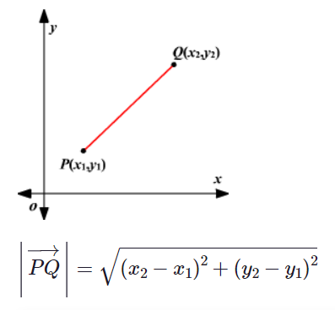
Vectors Magnitude
The magnitude of a vector is the distance between the initial point and the end point. in symbols the magnitude of Q is written as
If the coordinates of the initial point and the end point of a vector is given, the Distance Formula can be used to find its magnitude.

Slide 51
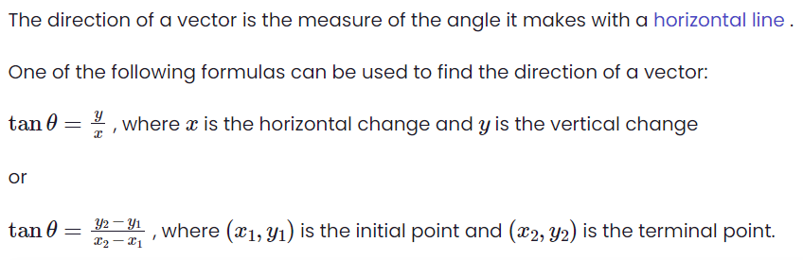
Vector Direction

Slide 52
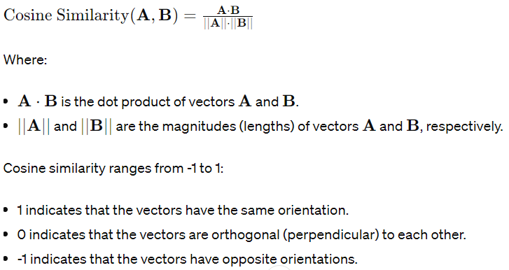
Cosine Similarity
Cosine similarity measures the similarity between two vectors of an inner product space.
It is measured by the cosine of the angle between two vectors and determines whether two vectors are pointing in roughly the same direction.
It is often used to measure document similarity in text analysis.

Slide 53
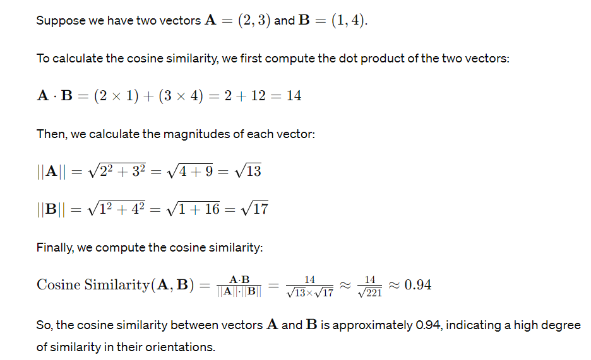
Cosine Similarity

Slide 54
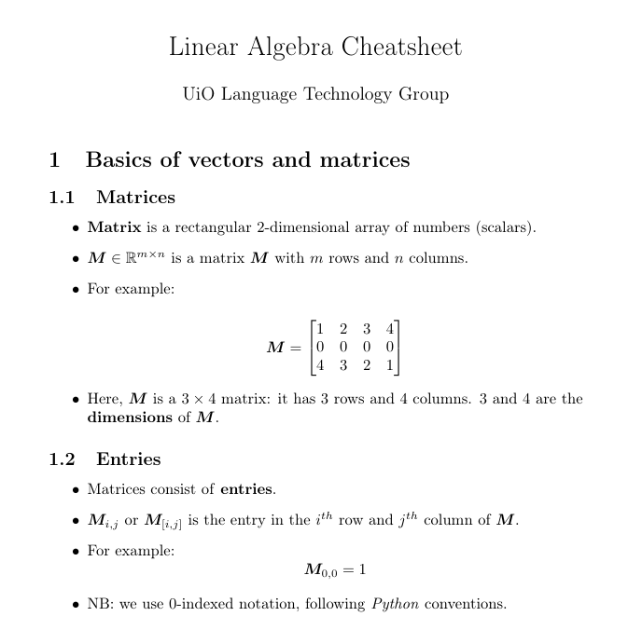
Matrices Operation
https://www.uio.no/studier/emner/matnat/ifi/IN5550/v22/la.pdf

Slide 55
Q&A
Questions and answers

Slide 56
Thanks

